Slide 1

Data and Analytics Journey
Complexity
Information Portal
Analytics Workbench
Data Science Laboratory
Reports
Dashboards
Online Analytical Processing (OLAP)
Self-Service Analytics & Data Preparation
Citizen Data Science
Predictive Analysis
Artificial Intelligence Hub
Machine Learning
Deep Learning
Prescriptive Analysis
Descriptive
Monitor
Diagnostic
Explore
Investigate
Perform

Slide 2
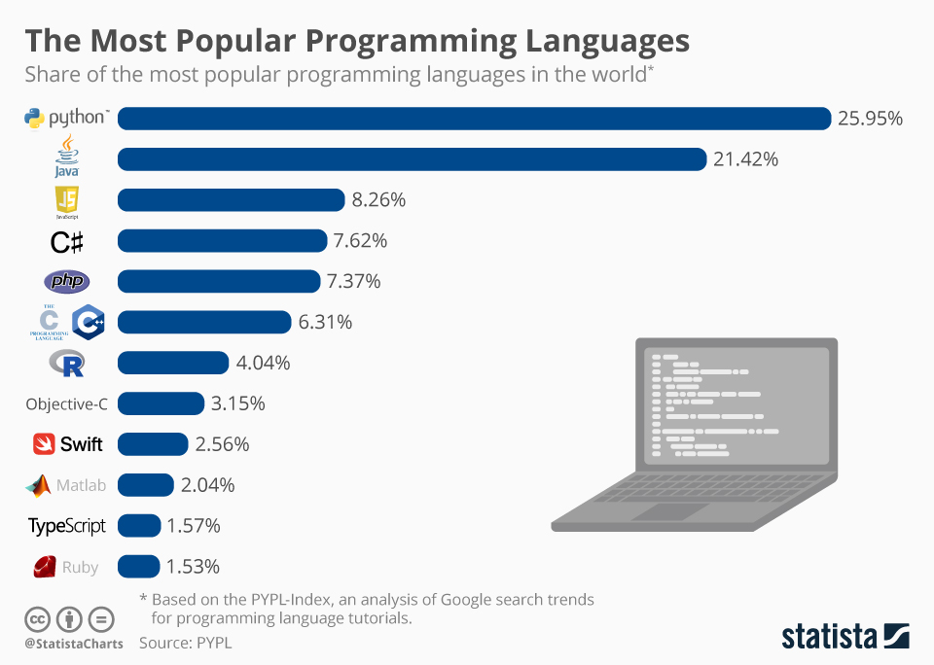

Slide 3
Why Python?
Friendly & Easy to Learn
Vast, online resources
Collaborative community
Industry standard for data analytics / data science
Open – Source
Freely usable and distributable
Applications+
Python Package Index
Thousands of 3rd party modules available for free import

Slide 4
Curriculum
Class Logistics:
We'll meet every two weeks for 30 mins
There will be an assignment after every class
The assignment MUST be completed before the next class
Lessons will be available via Zoom and recorded
Class Outline:
Python Basics (4 classes)
Pandas – data manipulation and analysis library (2 classes)
Matplotlib – plotting library (2 classes)
APIs introduction (1 class)
Final Project – apply to day to day job (custom pace)

Slide 5



Technology Ecosystem
Python – programming language
GitHub – where we access the curriculum
Anaconda – environment manager

Slide 6
Feedback
Please fill out the form!
https://cantel.sharepoint.com/sites/Analytics

